Slide 1
Combining machine learning with mechanistic models to understand plant resilience
Ben Noordijk
PhD candidate Bioinformatics

Slide 2
My background

Slide 3
Examples of machine learning in bioinformatics
Neural networks
Dimensionality reduction
Clustering
A. D. J. van Dijk, G. Kootstra, W. Kruijer, and D. de Ridder, iScience, vol. 24, no. 1, p. 101890, Jan. 2021, doi: 10.1016/j.isci.2020.101890.
Notes:
Used to doing ML, not necessarily mechanistic models
Typically, models lack interpretability

Slide 4
Reduce irrigation, pesticides
Extreme weather
Resilient plants
50% more food in 2050
M. van Dijk, T. Morley, M. L. Rau, and Y. Saghai, Nat Food, vol. 2, no. 7, Art. no. 7, Jul. 2021, doi: 10.1038/s43016-021-00322-9.

Slide 5
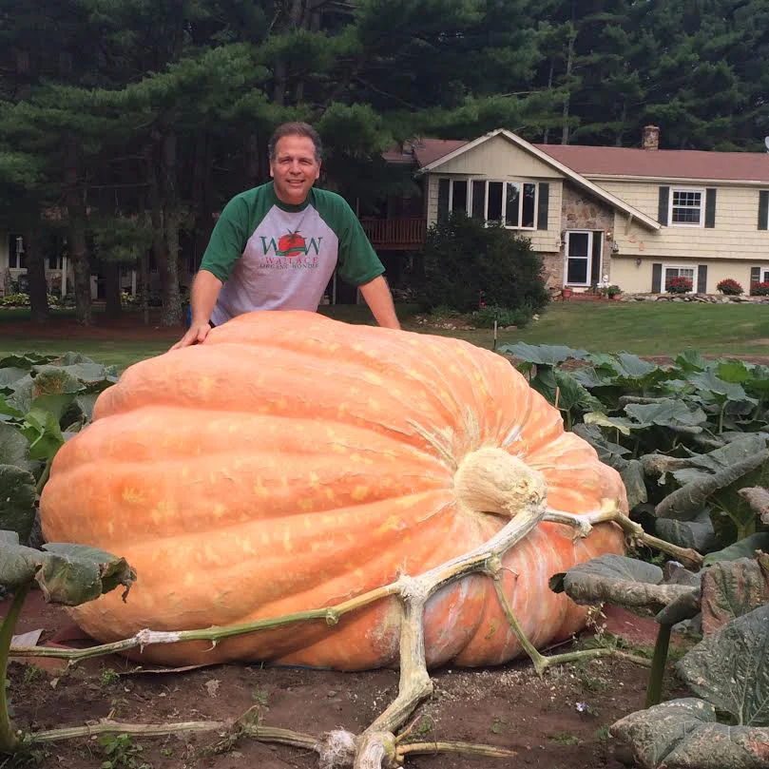
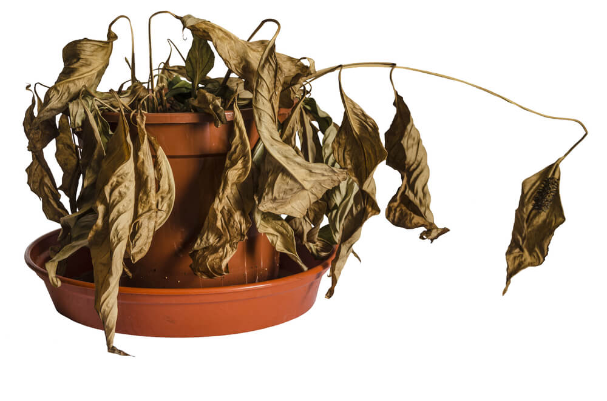
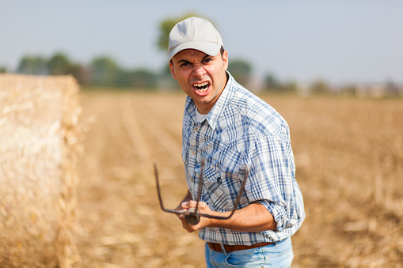
Resilience: the capacity to withstand or to recover quickly from difficulties

Slide 6
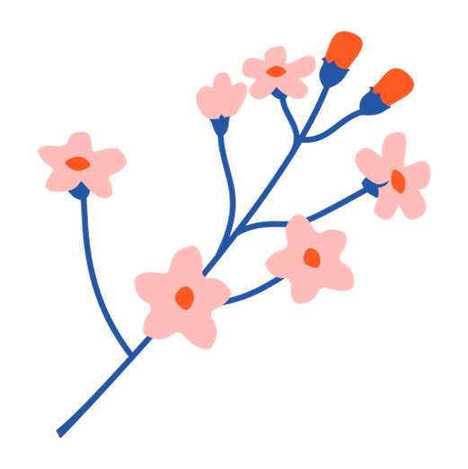
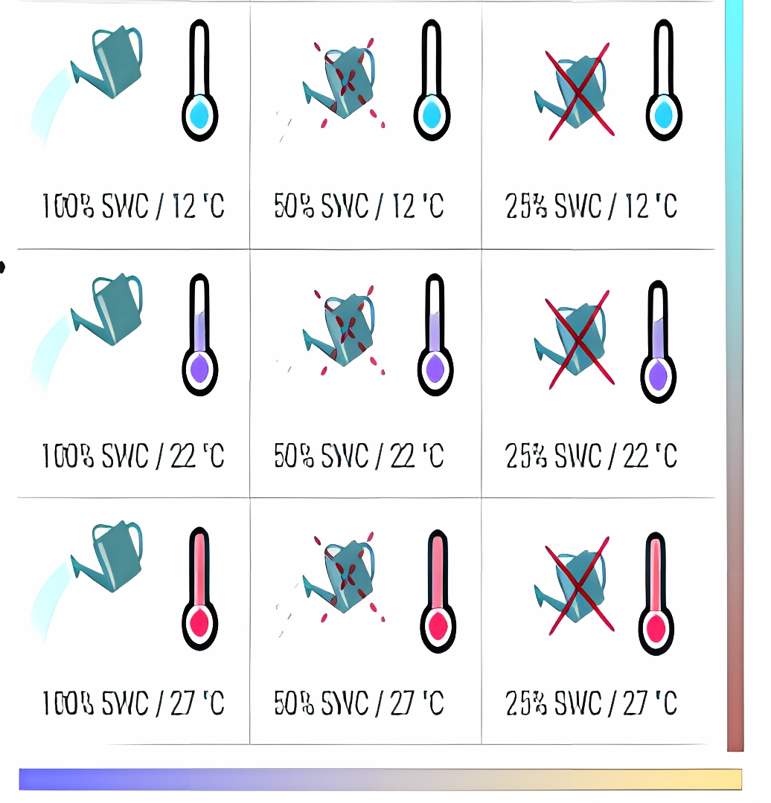
Plants integrate external stimuli over time
Notes:
Many of our foods depend on end of reproductive cycle (seeds/fruits)
‘Correct flowering time’ -> increased yield, greater reproductive success

Slide 7
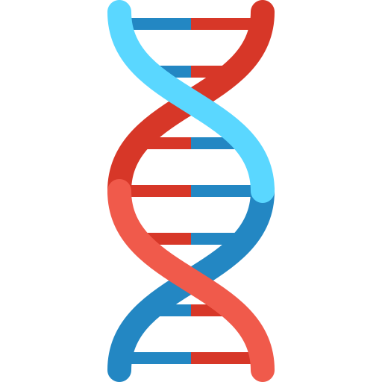
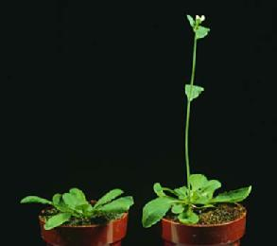
What determines plant characteristics?
Gene1
Gene2
>10 000 genes
Gene expression (mRNA):
Protein1 (enzyme for making starch)
Protein2
(Flowering time (FT))
L. Sterck, S. Rombauts, K. Vandepoele, P. Rouzé, and Y. Van de Peer, Current Opinion in Plant Biology, vol. 10, no. 2, pp. 199–203, Apr. 2007, doi: 10.1016/j.pbi.2007.01.004.

Slide 8
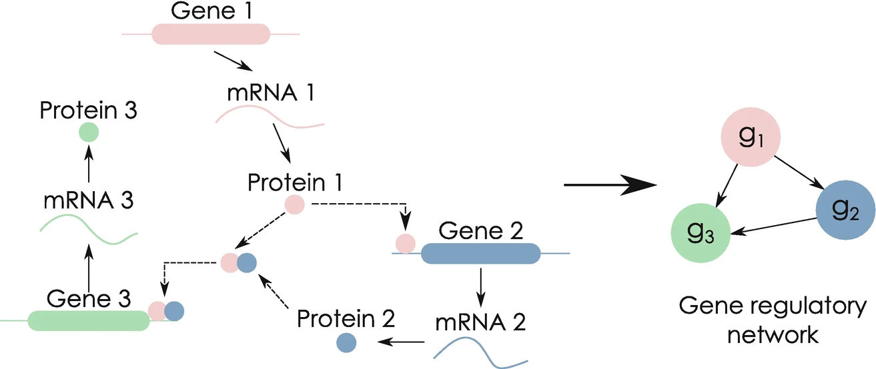
Gene Regulatory Network (GRN)
= Transcription
factor (TF)
Huynh-Thu, V.A., Sanguinetti, G. (2019). Gene Regulatory Network Inference: An Introductory Survey. In: Sanguinetti, G., Huynh-Thu, V. (eds) Gene Regulatory Networks. Methods in Molecular Biology, vol 1883.. https://doi.org/10.1007/978-1-4939-8882-2_1

Slide 9
Why care about the gene regulatory network of a plant’s response to stress?
Identify key genes
-> Breed more resilient crops

Slide 10
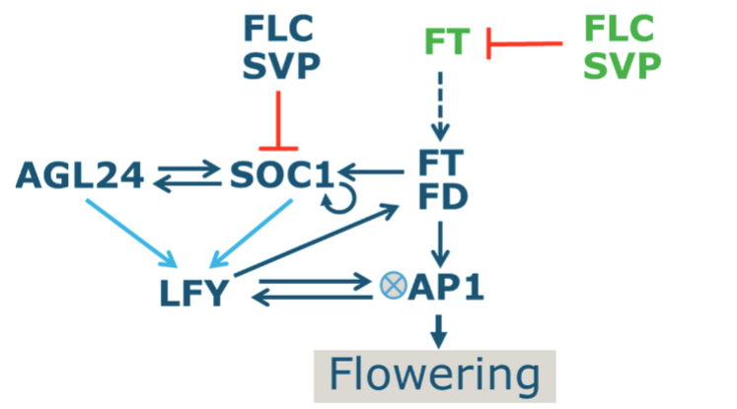
Small (<20 genes) regulatory networks have been unraveled
Ordinary differential equations (ODEs)
High interpretability
Tough to construct
F. L. Valentim et al., PLOS ONE, vol. 10, no. 2, p. e0116973, Feb. 2015, doi: 10.1371/journal.pone.0116973.

Slide 11
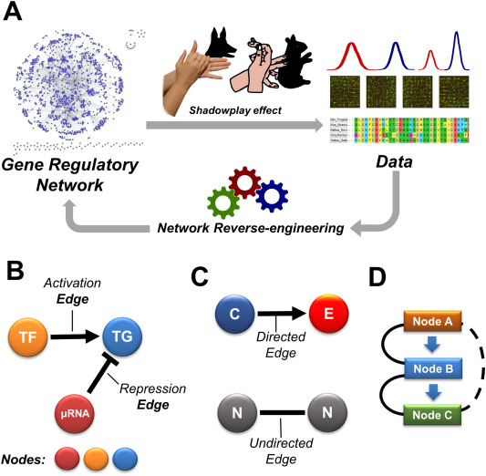
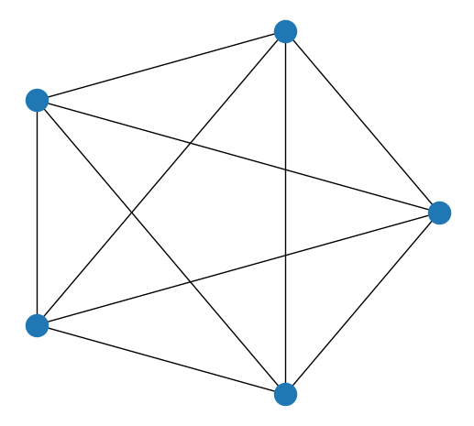
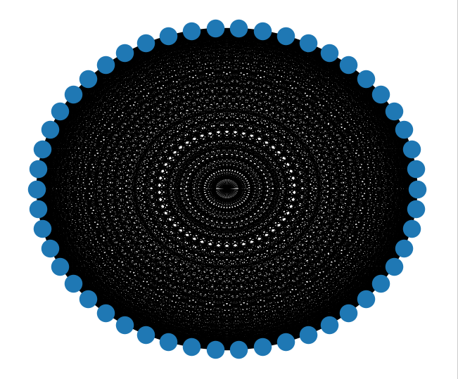
Network inference for many genes is unfeasible
Number of possible connections explodes
3 genes -> 15 connections
1000 genes -> ~2 million connections
D. Mercatelli, L. Scalambra, L. Triboli, F. Ray, and F. M. Giorgi, Biochimica et Biophysica Acta (BBA) - Gene Regulatory Mechanisms, vol. 1863, no. 6, p. 194430, Jun. 2020, doi: 10.1016/j.bbagrm.2019.194430.
Notes:
Left: 5 nodes
Right: 50 nodes

Slide 12
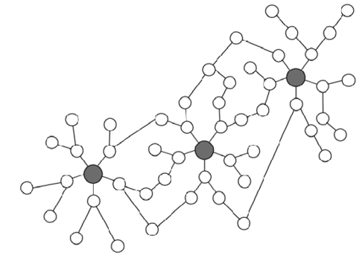
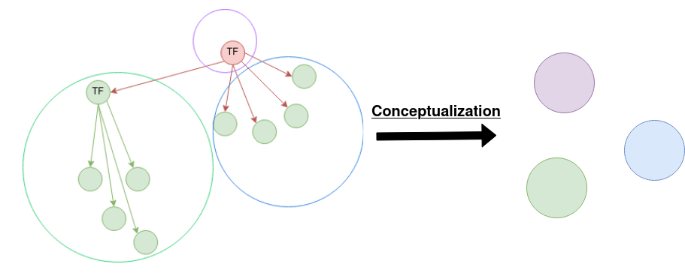
Gene modules simplify network inference
Genes bound by the same Transcription Factors.
Genes with similar expression pattern over different conditions.

Slide 13
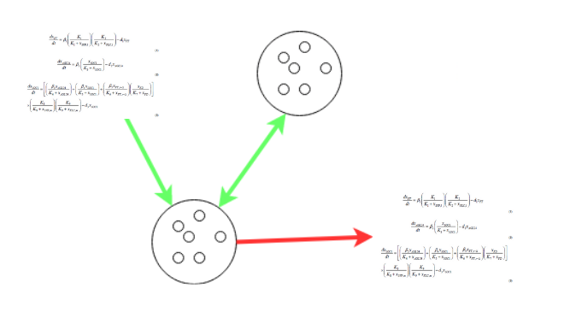
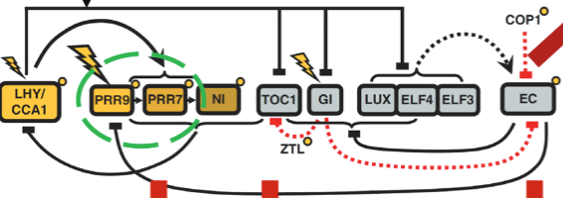
Combine modules with ODEs
Fill knowledge gaps in the mechanistic model
F. L. Valentim et al., PLOS ONE, vol. 10, no. 2, p. e0116973, Feb. 2015, doi: 10.1371/journal.pone.0116973.
Y. H. Chew et al., in silico Plants, vol. 4, no. 2, p. diac010, Jul. 2022, doi: 10.1093/insilicoplants/diac010.
Notes:
Fill up slide

Slide 14
Machine learning methods for module extraction
We use
We could try
Pearson correlation
Hierarchical clustering
Spearman’s rank correlation
Matrix-decomposition-based methods
Spectral clustering
Notes:
Think about the point of this slide

Slide 15
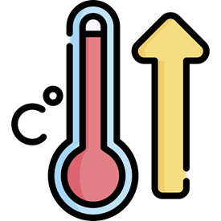
Model module expression in a public dataset
3 hours 38°C
21 hours recovery
Microarray gene expressions (8 time points)
 | 0 mins | 30 mins | 120 mins
Gene1 expression: | 1 | 10 | 1
Gene2 expression: | 0 | 11 | 1
Gene3 expression: | 5 | 2 | 4
Gene4 expression: | 6 | 3 | 4
… (~20 000 genes)
Module1
Module2
https://www.ncbi.nlm.nih.gov/geo/query/acc.cgi?acc=GSE5628

Slide 16
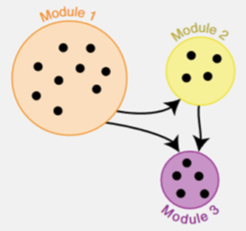
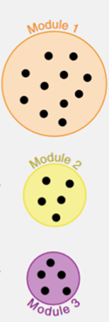
From modules to mathematical model
Cluster into modules
Network inference
ODE-fitting
Mean expression per cluster
Fit to experimental data
W. Saelens, R. Cannoodt, and Y. Saeys, Nat Commun, vol. 9, no. 1, Art. no. 1, Mar. 2018, doi: 10.1038/s41467-018-03424-4.

Slide 17
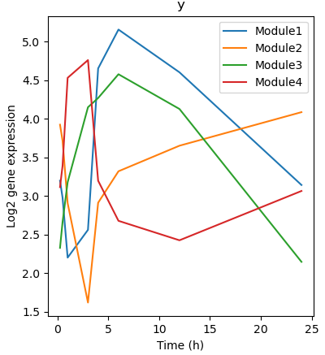
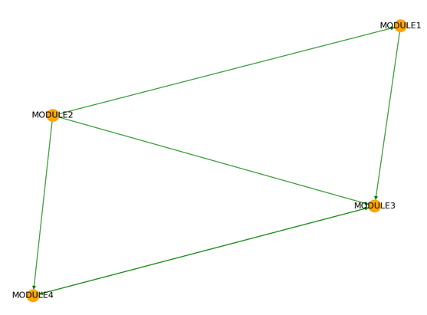
Initial results of fitting model

Slide 18
Conclusion
Machine learning
Mechanistic model (ODE)
Accurate, interpretable model
Gene module extraction
Dynamic prediction
Network inference
Prior knowledge
Flowering time prediction

Slide 19
Next steps
Improve ODE fitting
Combine modules with existing models to predict flowering time
Expression dynamics as input for network inference

Slide 20
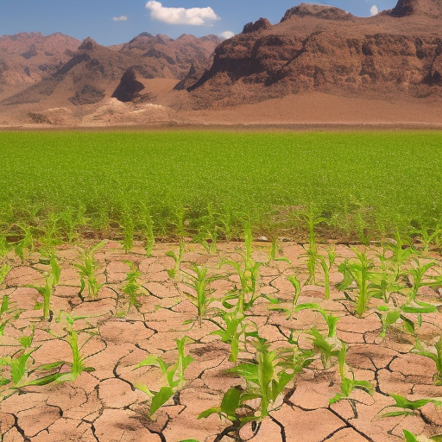
Thanks to:
Jordi Alonso Esteve
Aalt-Jan van Dijk
Dick de Ridder

Slide 21
Supplementary slides

Slide 22
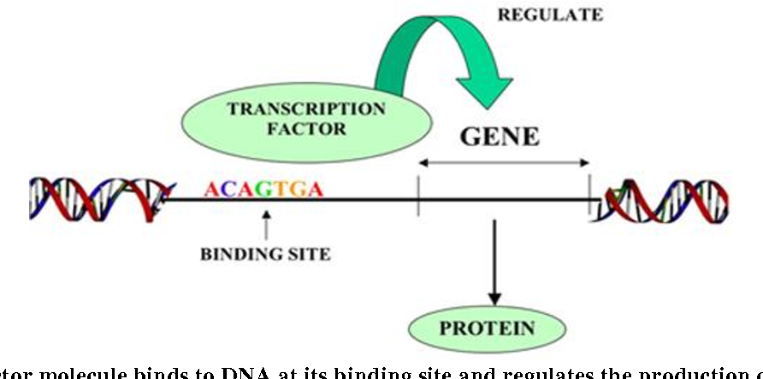
Transcription factor binding site
https://www.semanticscholar.org/paper/In-Silico-approach-to-identify-transcription-factor-Mubeen/0cd239525966e99aa071b215186295825c8c55b1

Slide 23
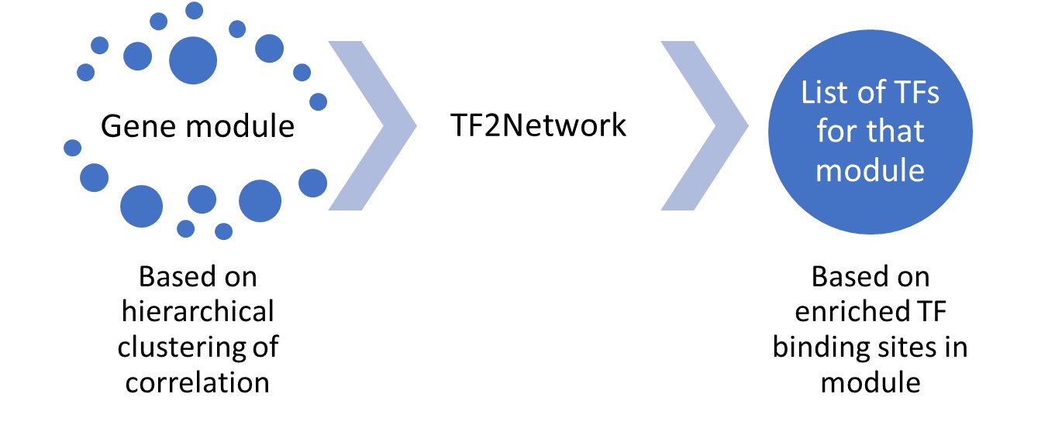
Find TF for each module

Slide 24
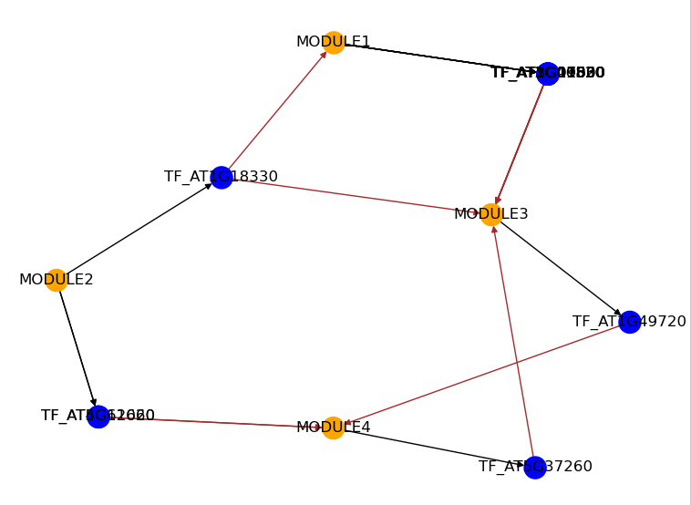
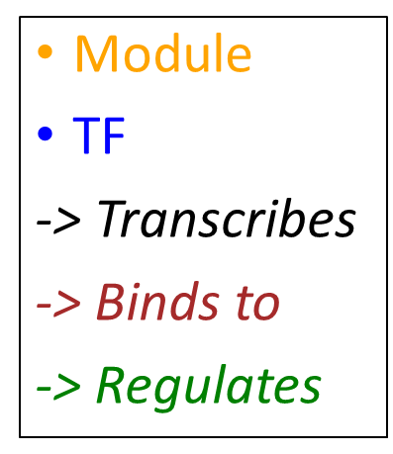
Module network inference
If TFs are transcribed by gene in module -> link modules to TFs

Slide 25
System of ODEs (dy/dt for each module)
MODULE0: beta_1_0 * y[1]
- delta_0 * y[0]
+ gamma_0 * temp
MODULE1: - delta_1 * y[1]
+ gamma_1 * temp
MODULE2: beta_0_2 * y[0]
+ beta_1_2 * y[1]
+ beta_3_2 * y[3]
- delta_2 * y[2]
+ gamma_2 * temp
MODULE3: beta_1_3 * y[1]
+ beta_2_3 * y[2]
- delta_3 * y[3]
+ gamma_3 * temp
Temp is a parameter that can be tuned (different first 3 hrs)
15 parameters

Slide 26
Parameter optimization (scipy)
Calculate solution to ODE for parameters
Calculate Loss
Update parameters
ODE solver (Radau)
Gradient-descent based (L-BFGS)
Mean squared error

